Slide 1
If you want to learn Microsoft Word…
…You better know these words

Slide 2

endnote
a note printed at the end of a book or section of a book.

Slide 3
Demote
To move a bullet point down a level
  Like this bullet here
This bullet has been demoted

Slide 4
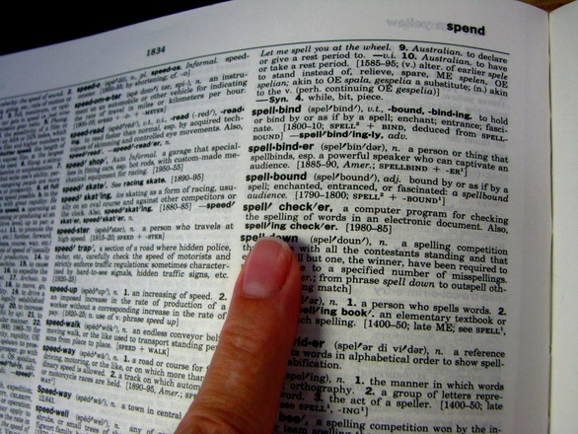
autocorrect
Checks your spelling and grammar automatically

Slide 5
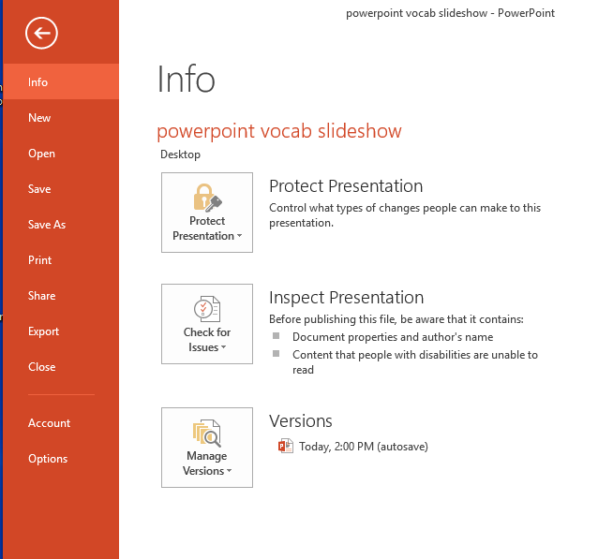
backstage
The file tab – where you can do things with your file like, share, print or save and protect it

Slide 6
Bullet list
A list with dots next to each informational item
A list with dots next to each informational item
A list with dots next to each informational item
A list with dots next to each informational item

Slide 7
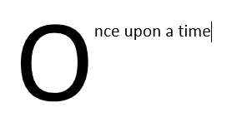
dropcap
when the first letter of a paragraph is a much bigger size than the rest that follow

Slide 8
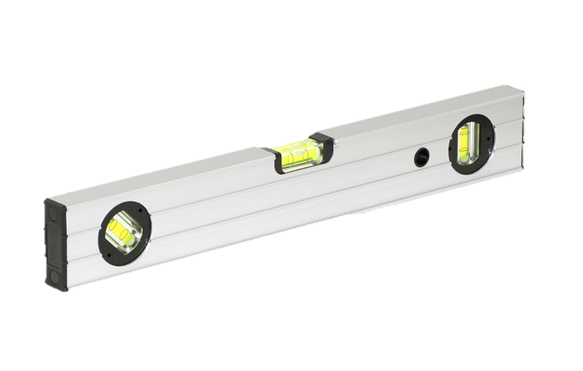
align
To line up, straighten

Slide 9
format
To change the way an object looks
To change the way an object looks

Slide 10
markup
Leaving comments on a document for others to read and review
There’s a comment (markup) here

Slide 11
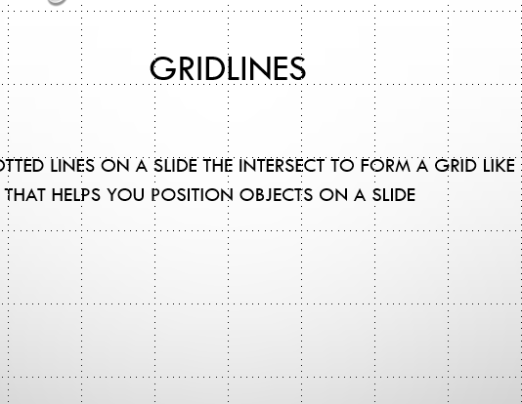
gridlines
The dotted lines on a slide the intersect to form a grid like patter that helps you position objects on a slide

Slide 12

footnote
an extra piece of information printed at the bottom of a page.

Slide 13
wordart
decorative text that you can add to a document.
WordArt WordArt
WordArt

Slide 14
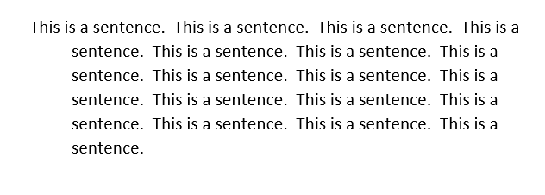
Hanging indent
indentation of a paragraph in which all lines except the first are indented

Slide 15
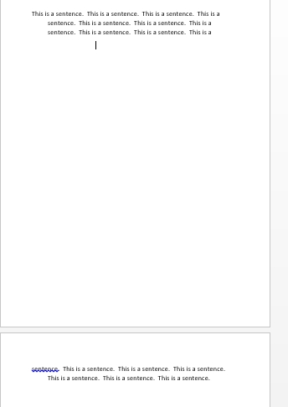
Page break
This tells the Microsoft word where to end the current page and begin the next

Slide 16
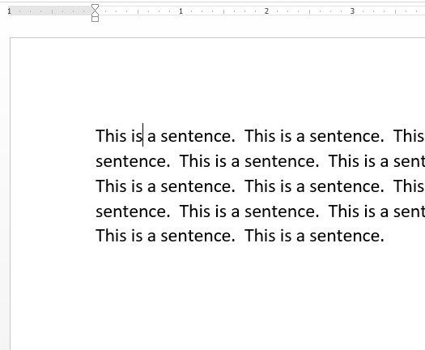
margin
the edge or border of something

Slide 17
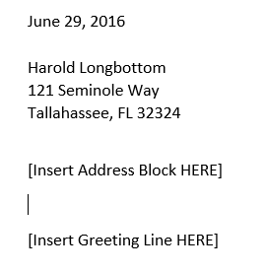
Mail merge
Importing of names and addresses from a database to letters, labels and envelopes to make sending mail to many addresses quick and easy

Slide 18
promote
To move a bullet point up a level
  This is a demoted bullet point down to level 2
This has been promoted back to level 1

Slide 19
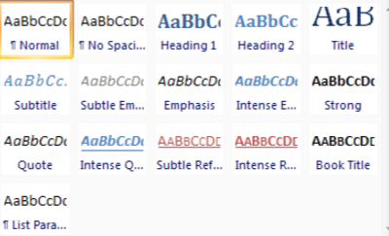
styles
Premade text, SmartArt, chart, table or image formatting so you can make objects look good quickly and easily

Slide 20
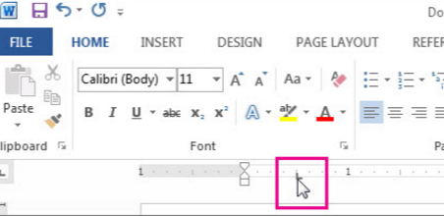
Tab stop
the location the cursor stops after the tab key is pressed

Slide 21

Tab leader
draws a dotted, underscored or dashed line from the current cursor location to the next tab stop.

Slide 22
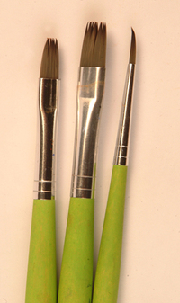
painter
A tool that allows you to copy animations or formatting easily from one object to another

Slide 23
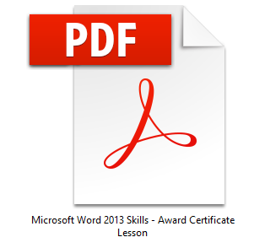
pdf
A type of file that can be opened for free on any device that allows read privileges but not editing privileges

Slide 24

Quick access toolbar
At the very top of the window, this toolbar contains commonly used action buttons like quick print, save and undo and can be customized by the user to include more buttons

Slide 25
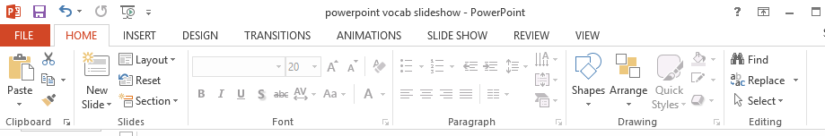
ribbon
The horizontal space at the top of the window that organizes commands in tabs, and then groups the commands by topic. It’s where all of your tabs and menus are.

Slide 26
header
©TechCheckLessons, 2022
Information located at the top of each slide or page, like the author name, the page number, the date…

Slide 27
footer
Information located at the bottom of each slide or page, like the author's name, the page number, the date…

Slide 28
hyphen
the sign (-) also known as a dash

Slide 29
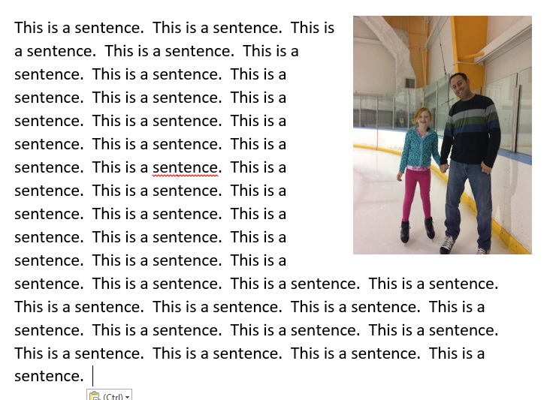
Text wrap
allows text to surround embedded features such as pictures.

Slide 30
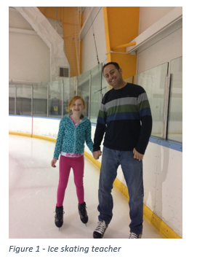
caption
provide (an illustration, chart or table) with a title or explanation.

Slide 31
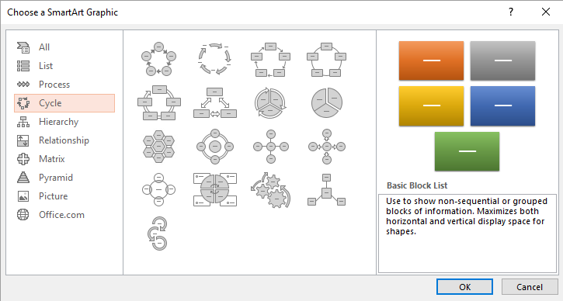
SmartArt
A cool way to representing your information -- organization charts, flowcharts, Venn diagrams, pyramids, etc.

Slide 32
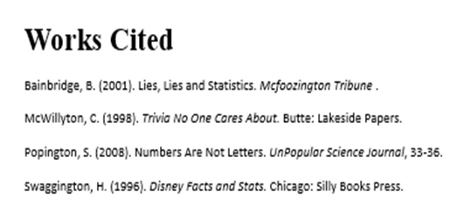
citation
a quotation from or reference to a book, paper, or author

Slide 33
hyperlink
A cool visual effect that happens when a presentation moves from one slide to the next slide.
  This is a hyperlink to www.google.com

Slide 34
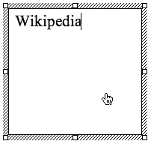
textbox
An on-screen rectangular frame into which you type text

